Slide 1
CSIT 6000P Final Project
Retrieval of multimedia and social media data
Group 12
Chen, Zhaoheng
Wang, Zijie
Ma, Daci
Huang, Lishan
Yuan, Fangxu
Notes:
Hi, welcome to our project in Retrieval of multimedia and social media data. We are group 12

Slide 2
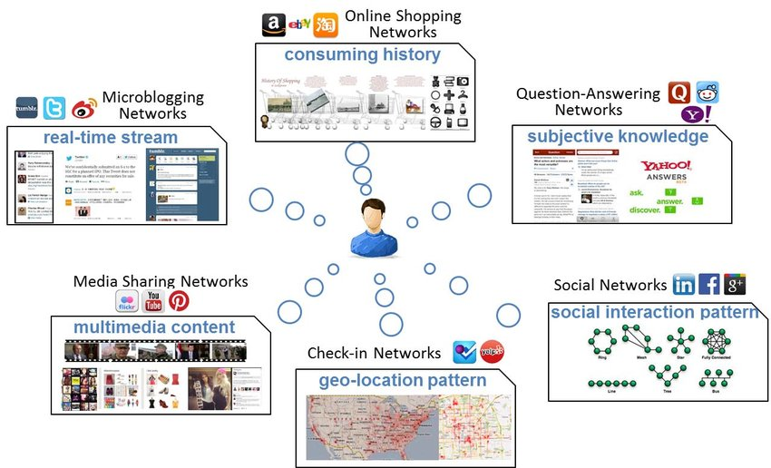
Introduction
Notes:
Retrieval of multimedia information has become an important topic since the development of the Internet has greatly expand the types of information that we transmit over the web. Users send numerous images, audios and videos on social media to share about their life, while researchers do a lot of work to find a way to collect, index and analyze these data, and eventually extract semantic meaning and information from the data collected.

Slide 3
Introduction
Three Types:
1. Multimedia information classification
2. Filtering multimedia information
3. Feature extraction and content description
Notes:
Methods for multimedia information retrieval can be generally categorized into three types:
In our project, we have chosen four papers in related area. We plan to figure out the mechanism introduced respectively. We hope to obtain a general view of multimedia and social media data retrieval.

Slide 4
Conclusion
Two Issues:
1. The quality of multimedia information retrieval depends heavily on the quality of the training data.
2. The classifier can only be as good as the given training data, it requires considerable effort to provide class labels for large databases.
Notes:
The papers we have selected cover all aspects of retrieval of multimedia and social media data with corresponding advanced techniques and perspectives.
The scope of our research does not only include the creation of image-based retrieval databases on social media, also cover innovative approaches to information retrieval based on natural language processing in social media
But there are two issues when we carry out the survey,
This report gives us an opportunity to get an overview about Retrieval of multimedia and social media data. In the future, we will do more in-depth research in the areas if we get the opportunity. Thank you for your listening.

